Slide 1
CIO / CTO Challenges and Opportunities in a Post Pandemic World – Hybrid Office, Cybersecurity, and New KPIs Gregory S. Smith CIO, Author, Professor
2022

Slide 2
Agenda
The Hybrid Office of the Future
IT Security for Corporate Resilience
Key Performance Indicators (KPIs) for the New Normal
CIO Priorities
Building Your Brand
Skills and Experience it Takes to Get to the Top Role

Slide 3
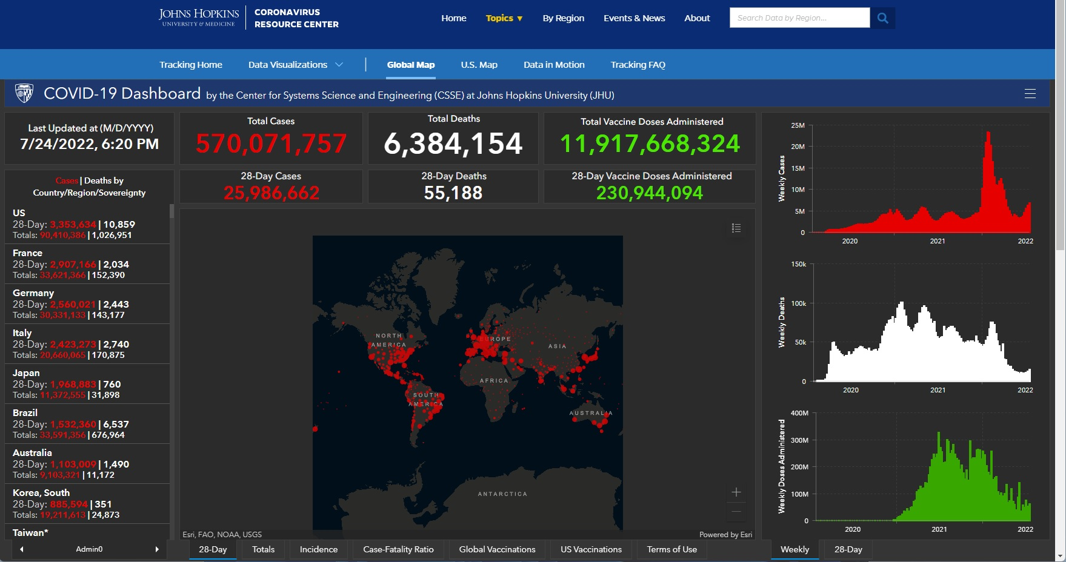
Lasting Business Impacts from the Pandemic
As of July 24, 2022

Slide 4
The Shrinking Office of the Future
Prior to the pandemic:
17 percent of U.S. employees worked from home for 5 days / week
During the pandemic:
44 percent of U.S. employees worked from home for 5 days / week
A very large majority of workers worked from home for less than 5 days / week
The impact of the global pandemic on workers around the globe accelerated a remote working trend as quarantines and lockdowns made commuting and working in the office close to impossible for millions of workers
Post pandemic survey from Flex Jobs found:
65 percent of employees report wanting to work remote full-time
31 percent of employees want a hybrid office / remote environment
96 percent of respondents want some form of remote work options
27 percent of respondents indicated they would take a 10-20 percent pay cut to work remotely

Slide 5
The Shrinking Office of the Future
Not all jobs are ideal for remote work. The McKinsey Global Institute looked at a variety of industries and concluded the best and worst to support remote work with no productivity loss:
Finance and insurance: 76 percent effective with no productivity loss
Management: 68 percent
Professional, scientific, and technical services: 62 percent
IT and telecommunications: 58 percent
Education: 33 percent
Wholesale trade: 41 percent
Real estate: 32 percent
Government and administration: 31 percent
Utilities: 31 percent
Mining: 19 percent
Transportation and warehousing: 18 percent
Construction: 15 percent
Hotels and food services: 8 percent

Slide 6
The Shrinking Office of the Future
The PriceWaterhouse U.S. Remote Work Survey found varying degrees between employers and employee's priorities of the corporate office environment:
Employers
Increase employee productivity
Provide a space to meet with clients
Enable employees to collaborate effectively
Preserve / enable the company culture
Employees
Expand collaboration capabilities
Accessing information and documents securely (mostly remote)
Meeting with clients and colleagues
Training and career development

Slide 7
The Shrinking Office of the Future
Global Workplace Analytics reported the following regarding attrition and productivity during the pandemic (likely holding post pandemic):
Attrition
14 percent of Americans changed jobs to shorten their commute
46 percent of companies that allow telework say it reduced job turnover
95 percent of employees indicated that telework had a high impact on their retention
80 percent of employees cited the cost of commuting to work as a challenge
Productivity
Best Buy, British Telecom, Dow Chemical, and others reported that teleworkers are 35-40 percent more productive
Oracle corporation indicated that employees spend about 60 percent of their commute time they save working via telework – making them more productive
American Express teleworkers were 43 percent more productive than their office-based workers

Slide 8
The Shrinking Office of the Future
Corporations are saving more than ever during the pandemic and into the future via:
Selling / subletting corporate real estate
IBM slashed real estate costs by $50M alone during the2020 year
The average savings for a full-time remote worker on real estate is $10,000 per year
Commuting costs
Commuting time at the largest cities in the U.S. cost the economy $78 billion in lost productivity
Adopting geographical-based pay
Google and other companies are transitioning to geographically-based pay
Example: San Francisco-based pay = 100%, Provo Utah = 85%

Slide 9
The Shrinking Office of the Future

Slide 10
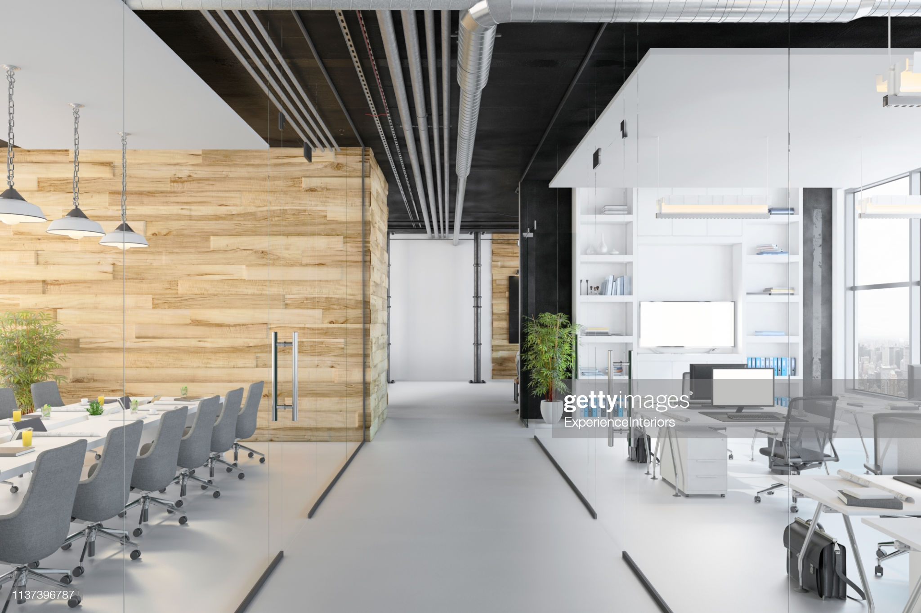
The Shrinking Office of the Future

Slide 11
The Shrinking Office of the Future
Predictions:
Corporate employees will demand more flexible working environments or walk.
Residential real estate outside of major cities will rise in value faster as workers look for cheaper places to live / work remotely.
Corporations will reduce their costs by selling / sub-letting real estate and reducing pay by geo-location standards.
Telehealth options are here to stay. Insurance carriers will adopt to save costs.
Fast food restaurants around the globe will retool their business with less in-person dining and more mobile / drive through options.
Remote work options will correlate higher to industries and sectors with a higher degree of success.
Companies will start compensating remote employees for incidentals like desks, good Internet, and fast wireless routers.
The desktop PC is dead and will be replace by mobile laptops and secure remote access solutions.
Snow days in America and around the globe are gone. Workers will be expected to work from home or take leave, saving companies more money.

Slide 12
IT Security for Corporate Resilience
The state of IT security today:
2020-2021 were some of the toughest years for organizations as many were hit with ransomware attacks, which dramatically increased during Covid-19.
Colonial Pipeline (Darkside was behind the attack the disrupted fuel distribution for weeks with 90 percent of U.S. east coast stations out of fuel)
Acer (REvil asked for a $50 million ransom after exploiting an issue in a Microsoft Exchange server)
JBS Foods (REvil hit the group and received $11 million in ransom)
Quanta (REvil hit this supplier to Apple and demanded $50 million in ransom)
NBA (Babuk stole 500GB of confidential information from the Houston Rockets)
AXA (Avaddon hacked the company and stole 3TB of data after the company announced changes to their insurance policies)
CNA (Evil Corp encrypted 15,000 devices, including those used by remote employees)
Kia Motors (DoppelPaymer released some of Kia’s stolen data and demanded $20 million in ransom from the automaker)

Slide 13
IT Security for Corporate Resilience
A subset of state and non-state actors:
North Korea
Labrinth Chollima – targeted the healthcare sector
Silent Chollima – targeted the healthcare sector
Velvet Chollima – targeted healthcare and government sectors
Iran
Charming Kitten– targeted the healthcare sector
Static Kitten – targeted healthcare and government sectors
China
Pirate Panda – targeted the government sector
Regional Wave Activity Cluster
Other regions / risks
Twisted Spider (Eastern Europe, Russia)
Wizard Spider (Eastern Europe, Russia)
Doppel Spider (Easter Europe, Russa)

Slide 14
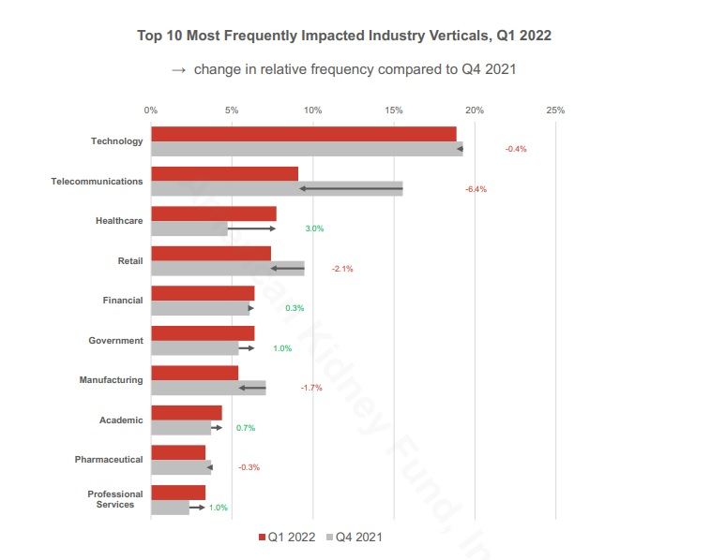
IT Security for Corporate Resilience

Slide 15
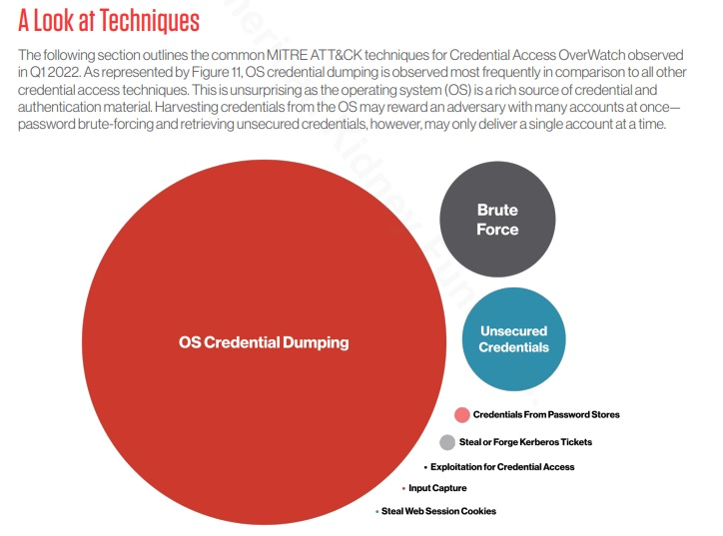
IT Security for Corporate Resilience

Slide 16
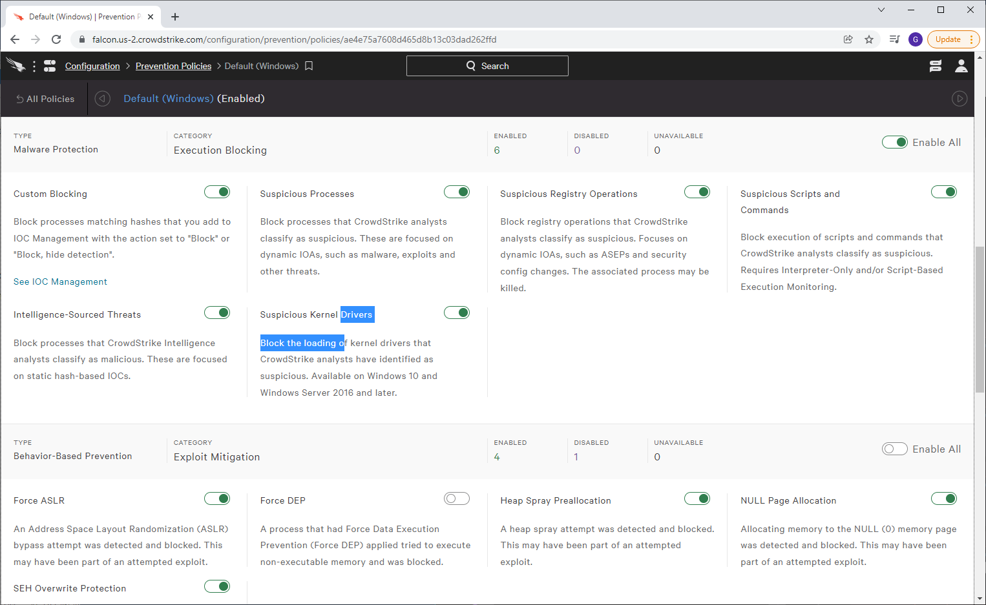
Advanced Anti-Virus Configuration Prevention Policies

Slide 17
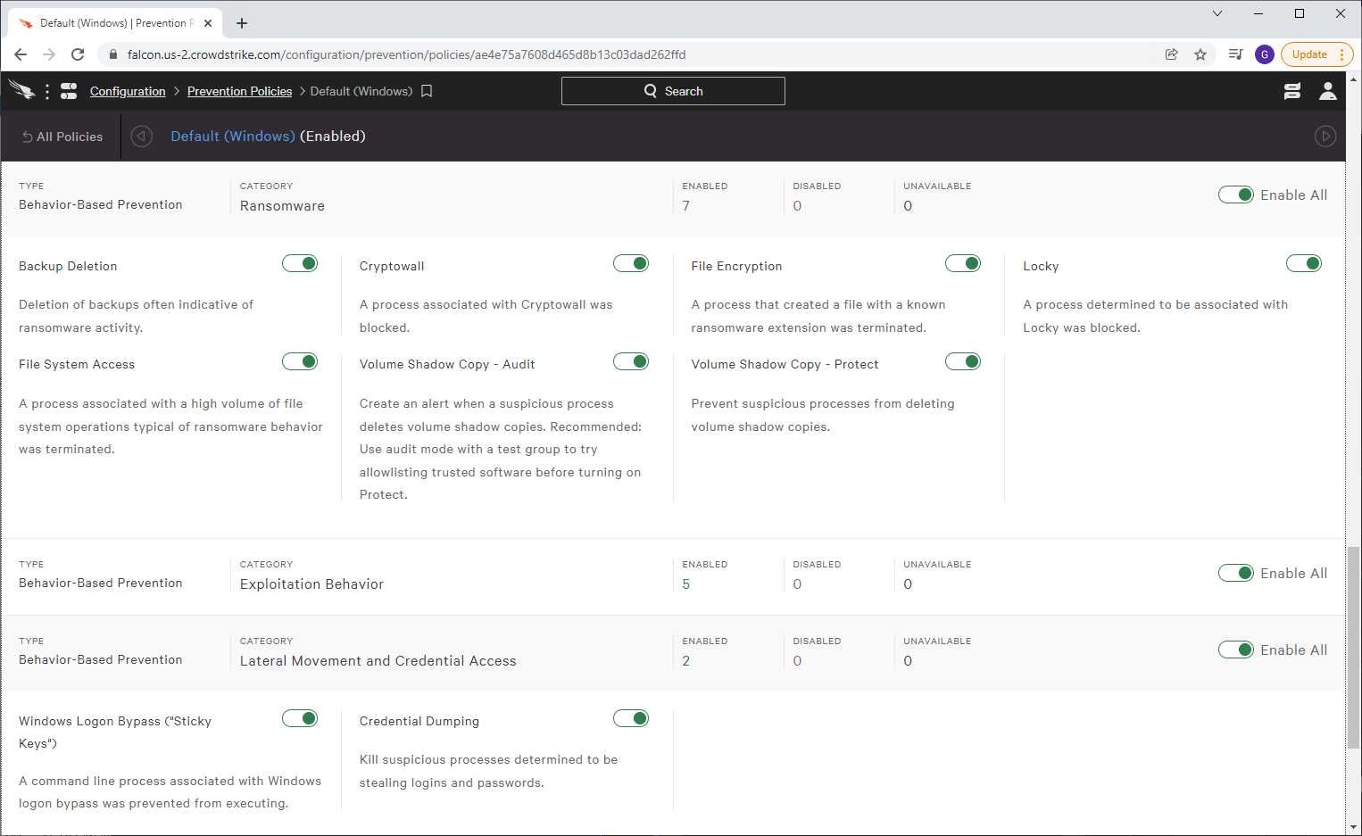
Advanced Anti-Virus Configuration Prevention Policies

Slide 18
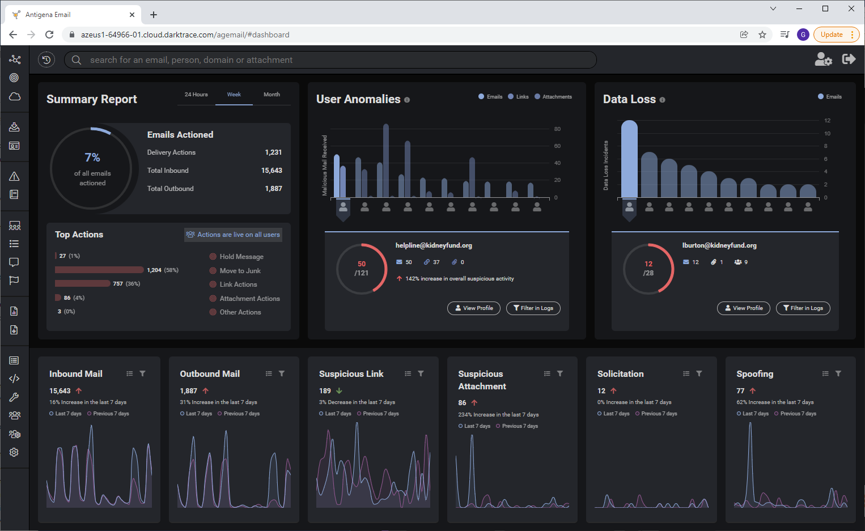
Advanced Email Security (DarkTrace) Dashboard

Slide 19
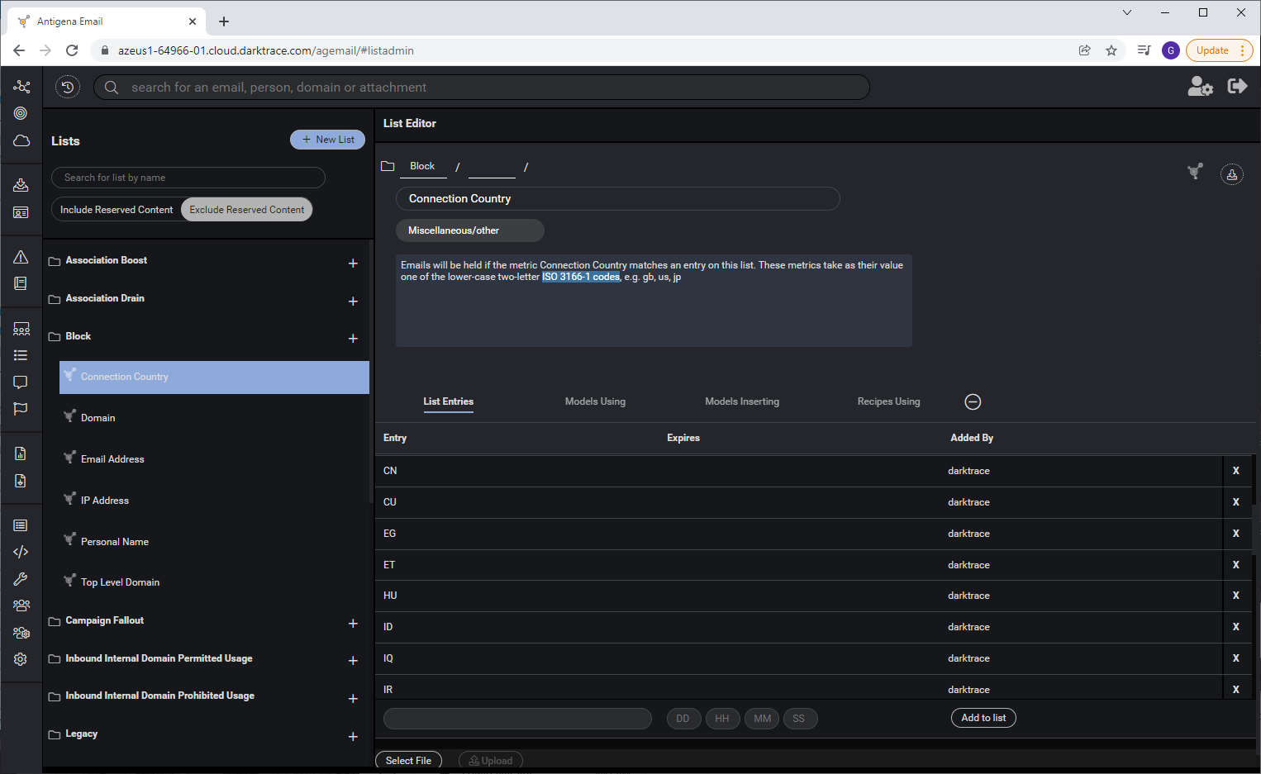
Advanced Email Security (DarkTrace) with Geo-IP
Geo-IP blocking by ISO 3166-1 country codes. (Ex: CU = Cuba, CN = China

Slide 20
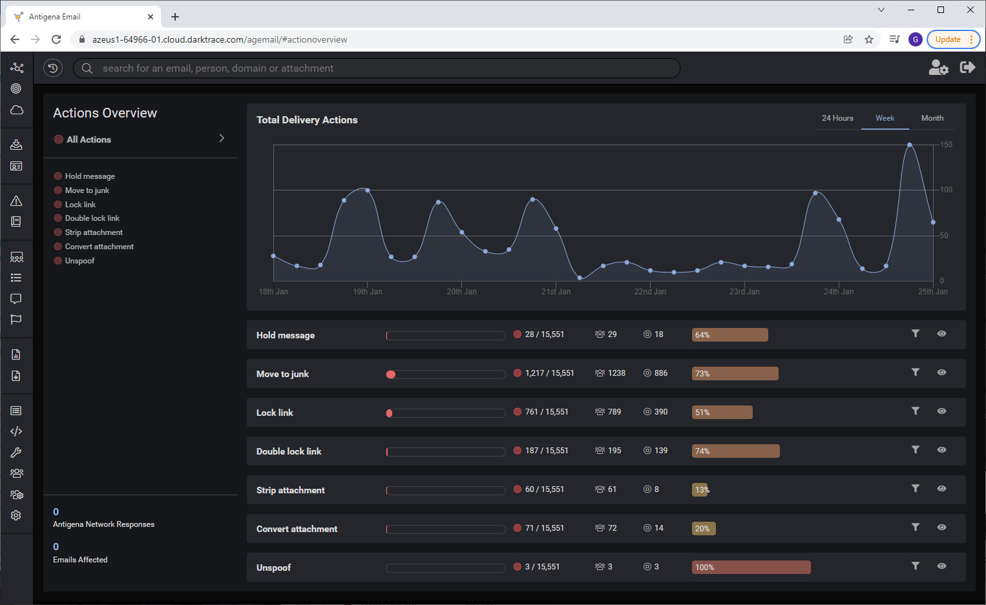
Advanced Email Security (DarkTrace) Actions Taken

Slide 21
Cybersecurity Readiness Today – Offense, Not Defense
Best Practice IT / Cybersecurity Actions
1. Maintain a formal IT Security / Cyber Security Policy.
2. Maintain a formal Incident Response Plan (IRP).
3. Leverage best practice AI-based SaaS tools (DarkTrace) that protect email systems from risks (phishing, etc.). Leverage Geo-IP capabilities within these tools to block risky countries from sending email to your system.
4. Limit “administrative” rights to only key IT staff.
5. Use 2-Factor authentication (application-based, not SMS) for remote access to secure portals, systems and data.
6. Encrypt all Internet-exposed applications (TLS 1.2+) and remote access solutions.
7. Maintain firewalls to protect internal systems and data from Internet risks and leverage very aggressive rules to protect systems and data. Leverage Geo-IP blocking on risky countries (China, Iran, Russia, DPRK). Restrict or block RDP.
8. Implement best practice anti-virus software for servers and computers that leverage AI capabilities (CrowdStrike).

Slide 22
Cybersecurity Readiness Today – Offense, Not Defense
Best Practice IT / Cybersecurity Actions
9. Block USB drives on company computers.
10. Conduct annual external penetration tests to validate protection of systems and data from the Internet. Conduct internal vulnerability assessments every year to ensure data safety.
11. Leverage best practice Managed Detection and Response (MDR) solutions (CrowdStrike, Expel) across server and end-user computers.
12. Update / patch software on computers / servers frequently.
13. Backup data and plan / test IT Disaster Recovery annually.
14. Train staff on cyber security risks, including phishing simulations.
15. Implement Internet content filtering solutions to prevent staff from accessing harmful sites on the Internet (gambling, adult content, freeware / shareware, weapons, etc.) that have ransomware risks.
16. Leverage Privileged Access Management (PAM) and SOCaaS solutions for access to critical systems and data (cloud and on-premise).

Slide 23
IT Security for Corporate Resilience
Predictions:
U.S. Cybercommand will take more aggressive actions against state and non-state actors who threaten the U.S. and the world.
Cybersecurity tools and vendors will continue to improve into 2025 at a rapid pace due to increasing threats.
There will be some consolidation in the marketplace as larger vendors buy smaller, more advanced solutions and incorporate them into their security portfolios (think DarkTrace and Microsoft).
Organizations will adopt more aggressive approaches to mitigating risks (such as advanced email protection, MDR, AI-based anti-virus solutions, and Geo-IP blocking at portals, websites, and firewalls).
Organizations that don’t adopt cutting edge tools will be impacted at a higher rate than those who do.
Spending on IT security solutions and tools will rise through 2025.
Sale of ransomware packaged toolkits (that allow hackers to deploy without writing a single line of new code) will continue to be a threat as more groups look to profit off of organization’s lack of readiness.

Slide 24
Key Performance Indicators (KPIs) for the New Normal
Common IT KPIs pre-pandemic:
IT spend vs. plan (capital and operating) – monthly
Application and service cost spend – monthly
Infrastructure unit costs vs. targets – monthly
Percentage of projects on time, on budget – monthly or quarterly
Percentage of business facing services meeting SLAs – monthly
Percentage of IT investments running, growing, or transforming the business – monthly or quarterly
IT spend by business unit – monthly
Customer satisfaction scores – monthly
Helpdesk cost per ticket - monthly
Helpdesk resolution within SLAs by severity, plus first response time - monthly
Mission critical application system uptime / availability – monthly
Application code change bugs - quarterly

Slide 25
Key Performance Indicators for the New Normal
KPIs of the future?
Employee health
Employee happiness
Employee performance / productivity (in-office vs. remote; 4-day work week vs. 5)
Customer satisfaction
Customer retention %
Growth %
Net Promoter Score (NPS)
Ability to deploy digital tools
Satisfaction with IT remote access, collaboration tools
Percentage of revenue from new products
Number of products under development
Capital IT projects scorecards health (scope, schedule, budget, resources) – green, yellow, red indicators with thresholds for each level
Expense per employee
Revenue per employee
IT cost per employee (IT operating $ / # FTE)

Slide 26
Key Performance Indicators (KPIs) for the New Normal
Predictions:
Organizations will adopt new KPIs surrounding operations, products, market and reputational impact, risk and sustainability, and talent / culture as a result of the pandemic.
Organizations that move more rapidly to adopt talent, culture, and tool productivity KPIs will retain the larger percentage of key staff.
Candidate employees evaluating new companies will inevitably weigh the flexible work environment and delve into how organizations will redefine their workforce KPIs to better value remote workers compared to traditional in-office workers. In the past – remote workers have trailed in raises and promotions.
Productivity metrics will emerge in organizations that offer flexible working environments to ensure that team members are meeting performance standards, regardless of where the work.
Organizations are just beginning to revamp their key KPIs, including IT. Stay tuned as they will evolve and change in the next 12-18 months.

Slide 27
Updated Research and Trends
Current Trends:
Government vaccine mandates are failing
Citizens are tired of containment strategies that don’t match the science
Parts of the world are in recovery, while others are experiencing additional waves of infection – especially for unvaccinated or non-boosted citizens
Vaccination rates vary greatly across the globe with many countries well below CDC guidelines on vaccination percentages – resulting in growth of future variants
Boosted citizens in developing and industrialized nations is falling significantly behind initial vaccination rates
It is likely inevitable that we’ll experience a variant that is vaccine resistant
Smart CEOs, COOs, and CIOs are planning for uncertainty in the future and doubling down on 1) cybersecurity, 2) cloud adoption / migrations, and 3) remote access solutions and collaboration capabilities

Slide 28
CIO / CTO Priorities
CIOs must plan digital strategy initiatives and shape the IT department to align with new business needs. IT governance post pandemic is key.
IT leaders need to consider the “reinvention” of IT to reach the next normal:
Adapt IT to enable the business or government to flourish
Accelerate IT to support business growth and change
IT leaders need to fulfill four critical roles on the future of IT:
Architect, orchestrate, integrate, manage ecosystems of digital technologies and assets from evolving sources
Build organizational resilience, agility, scalability, and security
Lead and govern the evolution of enterprise digital products and services
Create innovation factories that deliver sustainable streams of customer software and digital technology applications
CIOs must align with multiple stakeholders at the same time.
CIOs need to prioritize mobile, cloud, business continuity and disaster recovery worst-case scenarios, and plan for waves of disruptions (workforce, facilities, supplies, etc.)

Slide 29
Conclusion
Global Risks / Trends:
Omicron BA4 and BA5 are spreading across a variety of countries with significant mutation changes
BA2.75 has been detected in 10 countries and has 11 changes compared to BA5
Vaccination rates with booster shots vary greatly in countries
Hong Kong is in the throes of a severe wave of BA.2 and has the highest Covid-19 death rate in the world
China recently placed 17 million residents in lockdown
BA5 is now the dominant strain in the U.S. and a variety of countries
The United States is only vaccinated in the low 70’s percent of the population and only 50 percent boosted – increasing the risk of illness
Due to home testing, the actual number of positive Covid test results is 10 times higher than what is being reported by Johns Hopkins University
Bottom Line: We are NOT out of the woods. Plan for waves of disruption.

Slide 30
Build Your Brand (Students)
Only YOU can manage your career growth
Build your brand and start early
Add incremental growth to your resume and most importantly – push yourself outside of your comfort zone
Publish articles to help build your brand
Speak at industry events – starting small and growing to larger audiences
Teach at an undergraduate or graduate level
Be DELIBERATE and follow a strategy

Slide 31
A Road Map to the CIO / CTO Role – Skills Needed to Acquire Along the Way
CIO
15 – 25
years experience
IT Policies & Governance -
Cybersecurity & IT Security -
- Strategic Planning
Excellent Communication Skills-
- Audit & Compliance
Business Acumen - -
- Vendor Management and Contract Negotiation
Budget Planning & Oversight -
Staff Management -
- Project Portfolio Management
Agile / Waterfall Methodologies -
Consulting Experience
University Education
Multiple languages
Design
UI Experience
Database Design / Development
Advanced testing tools
Mobile first and mobile app
Project management
Security
Project Management Leadership
- Software Development (SQL and NOSQL databases)

Slide 32
Questions?

